Slide 1








2017
G.I.F.T. DAY
GIRLS IN FUTURE TECHNOLOGIES DAY
September 27th
BROUGHT TO YOU BY

Slide 2

AGENDA
8:30 Registration
9:00 Ice Breaker
9:05 AMA Opening Presentation
9:06 Representative Greeting
9:10 Presentations
9:15 Ken Sook
9:25 Dismiss to Workshops
9:30 Session I
10:20 Session II
11:10 Session III
Noon Lunch
12:25 It Can Wait
12:33 Speaker I
1:03 Speaker II
1:33 MCC Representative
1:43 Survey
1:48 Closing Remarks
1:53 Group Photo
1:56 Pick-up Backpacks
2:00 Depart
2:10 Fireside Chats
4:10 Lessons Learned Meeting

Slide 3
PANEL DISCUSSIONS
Think Tank – Planning Challenge
Trades
Future Forward
Scholarships
Internships
Employment
Entrepreneurships
Tech-Start Up
Workshops
Financial Aid
College Readiness
Engineering NSBE
Build the Cloud
Air Gig
Flying Cow
CSI
Data Analysis
Eve of Creativity
Minddrive
Fun with Media
Speakers
Neelima Parasker
Maggie McCracken
Ken Sook
Fireside Chat
Keynote Speakers
Kansas City Metro Area Professionals

Slide 4

PARTNERS
MCC & ASPIRE
WOMEN OF AT&T
SPONSORS
WOMEN OF AT&T (Chapter & National)
The NETwork national
Pioneers (Lewis & Clark)
MCC (Metropolitan Community College Business & Technology Campus
GUESTS
Students and chaperones – Thank you for making this possible.
PRESENTERS
Your kindness, generosity, and willingness to give of yourselves for a full day is greatly appreciated.

Slide 5
VOLUNTEERS
Who excitedly said yes, committed and delivered.
THE PLANNING COMMITTEE
Who worked tirelessly.
AT&T STORE
For showing up in a BIG way!
AT&T EXTERNAL AFFAIRS
Who helped to connect all the dots.

Slide 6

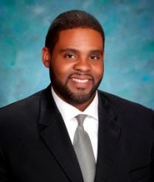
LEO ANDERSON
Leo Anderson attended the University of Missouri-Columbia and the University of Central Missouri. He was instrumental in designing mobile phone technologies such as mobile data, Push-to-Talk and text messaging. He holds 13 United States patents and is employed with AT&T as a Manager in the Entertainment Group.

Slide 7
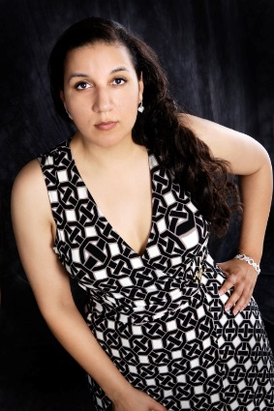
DENISE BIFFORD, MBA
Born in Sasebo, Japan (military brat). Traveled all over the globe.
At Baker University
Associate of Arts in Business degree in 2001
Bachelor of Science in Business Management degree 2003
Masters of Business Administration 2006
Executive Vice President Kansas City Chapter – Community NETwork 2013 & 2014
Local Ambassador ASPIRE 2014 & 2015 – Kansas City/Joplin
Sales Manager – Fiber To The Building (OK, KS and KCMO) 2014-Present
Business Technical Sales Consultant II, 2008 to 2014
Business Onboarding Development Specialist, 2007
Business Technical Sales Consultant I, 2001 to 2006
Residential Customer Care Unit Escalation Manager, 1997 to 2001
Residential System / Market Readiness, 1996 to 1997
Residential Customer Service, 1993 to 1996
I am passionate about working out and being more physically fit.
I am interested in learning more about nutrition.
I have worked both on the consumer and business segments of AT&T. I have also been occupational and management. I can see a broad view of all perspectives.
As of 2017, I have 23 years with AT&T. Woo Hoo!

Slide 8
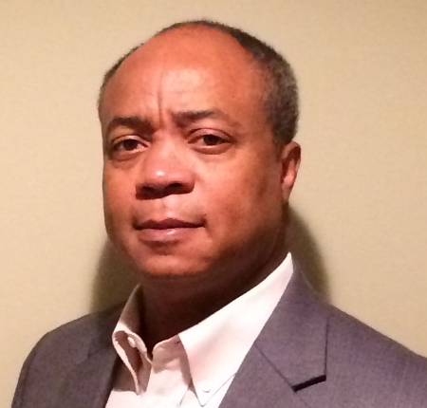
JOHN BRADY, MBA
Bachelor’s degree in Business Administration from Southwestern College in Kansas, Master of Business Administration degree from Rockhurst College and Michigan State University Certification in Labor Relations. Have held positions in staffing/recruiting, human resources, labor relations, finance, international human resources for large companies including Kraft Foods, Miller Brewing, Philip Morris, Payless Shoe Source, Cricket Communications and AT&T. Married for 30 years with 3 kids and 1 grandson. Lives in Parkville, Missouri.

Slide 9
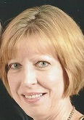
KAREE CRAIG
Karee retired at the end of 2013 as an Executive Assistant from AT&T with over 33 years of service. Karee joined Southwestern Bell in 1980 as a Senior Stenographer in Kansas City, MO. From there she served as a Service Representative until she was promoted to an Administrative Assistant in 1989 and in 1999 to an Executive Assistant. She supported Directors and Executives in various departments such as Consumer and Business Services, Personnel, and Network Services until her retirement.
During her tenure at AT&T, Karee was Coordinator for AT&T Foundation’s Aspire Mentoring program for Western Missouri. Through her leadership more than 500 employees acted as mentors to over 2,000 students which resulted in an excess of 5000 volunteer hours since the program’s inception in 2008.
Karee holds a Bachelor of Business Studies from Dallas Baptist University with Cum Laude honors, as well as membership in Alpha Sigma Lambda and Alpha Chi National College Honor Societies.
Karee serves as Past President of the Missouri Chapter of AT&T Pioneers which boasts a membership consisting of 2700 employees and 8,900 retirees. AT&T Pioneers is a network of volunteers who effect immediate, tangible change in their local communities and are recognized as world-class leaders in volunteerism.
Karee has been awarded the President’s Volunteer Service Award by the President’s Council on Service and Civic Participation for volunteering more than 500 hours of community service in a calendar year. Karee has been honored twice with the National AT&T Pioneer Individual Excellence Award.

Slide 10
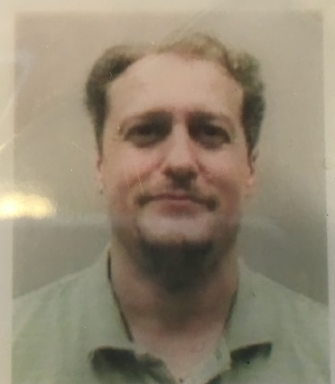
DAVID DEWEY, BIT
David Dewey obtained his Bachelors in IT with an emphasis in MIS Management Information Systems. Has worked for AT&T for 19 years as a consultant, providing technical support and guidance, to the design and build teams. Can always be found working at the Renaissance Festival each year; a member of (IHEA) Institute for Historic & Educational Arts.

Slide 11
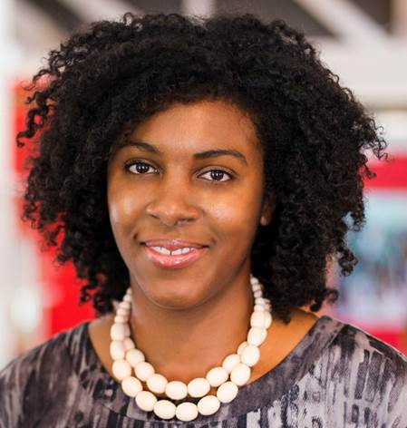
REBECCA DOVE
Rebecca Dove is a subject matter education expert. She has taught, trained, performed in sales and marketing, and managed others for over ten years. Rebecca worked for Cerner as an IT consultant where she trained and managed teams. Dove works as a Strategic Director and Education training for Project United Knowledge. She supports early-stage startups to grow and sustain their businesses. Dove is searching to empower underrepresented individuals to have life-long success.

Slide 12
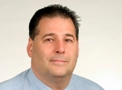
IRWIN GERSZBERG, Ph.D.
Irwin Gerszberg is Assistant Vice President of the Advanced RF Access Technology Organization for AT&T Labs in Middletown, NJ. His organization is responsible for Advanced RF Research Access technologies, Project AirGig™ , 5G, and numerous microwave/millimeter wave capabilities for: mobility cell site backhaul, small cell wireless transport, Enterprise, Telco and DirecTV within AT&T.
He holds a Bachelor’s degree and a Master’s in Computer Science from the New Jersey Institute of Technology and Stevens Institute of Technology. He joined the AT&T Bell System in 1978. While at AT&T Bell Laboratories, he managed large hardware/software projects for the Regional Bell Operating Companies (RBOCs) in advanced operations and testing of the local exchange network. In 1985, he spearheaded one of AT&T's first speech response/voice recognition trials with the RBOC’s. After joining AT&T’s Wireless unit in 1989, he was responsible for the development of numerous advanced wireless technology services.
He holds 160+ patents on local access technology covering Project AirGig™, Digital Subscriber Line, voice over DSL, IP based cable telephony, broadband wireless, broadband over powerline, Microcells, Satellite, WiMAX, High Definition Voice, IP telephony, and a vast array of emerging broadband infrastructure and services with the United States Patent Office.
Recognitions include:
2001 AT&T’s Science and Technology Medal
February of 2002 inducted into the New Jersey Inventors Hall of Fame by the Governor of the State of New Jersey for his innovations and contributions to science and technology in the telecommunications industry.
2004, he was awarded AT&T’s highest honor: The AT&T Fellow Award for his long term career in pioneering contributions and innovations for the telecommunications industry.
Member of the NJ Technology Council, Association of Public-Safety Communication Officials, Society of Cable Telecommunications Engineers, Institute for Electrical and Electronic Engineers (IEEE), NSSF, NRA.
Recognized industry expert and visionary consulted for the Wall Street Journal, Newsweek, San Francisco Chronicle, San Jose Mercury News, Oakland Tribune, Palo Alto Daily News, Star Ledger, Telephony Magazine, ABC Television, and many others. Irwin in the past has also provided testimony at numerous Federal Communications Commission (FCC) hearings on telecommunication policy.
Today within AT&T, Irwin Gerszberg is simply known as the inventor of Project AirGig™.

Slide 13
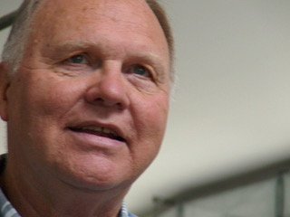
RON GREEN
Ron Green is a former high school teacher and a former editor and editorial manager with Hallmark Cards. He founded and led Hallmark’s Creative University program where he was responsible for training over 1400 talented professionals from a wide range of creative occupations. Ron also worked as a consultant for Mizzou Advantage’s Media of the Future program. He now serves as the Executive Director of the Digital Storytelling Center of Kansas City (digiSTORY KC). Here he works with kids in the urban core to develop their digital literacy and story making skills. He is also a member of the core team working to renovate the Laugh-O-Gram building at 31st & Forest in Kansas City, where Walt Disney launched his animation business.

Slide 14
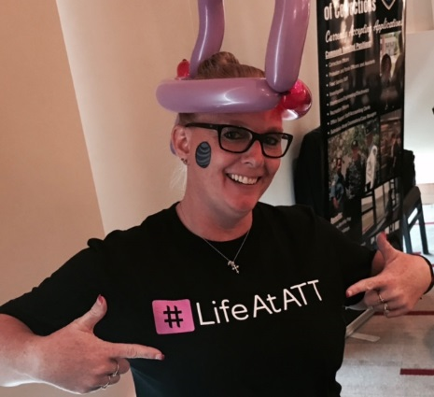
JAUNITA LIZOTTE
My name is Jaunita Lizotte, I was in the Army for 5 ½ years before joining AT&T. I have been with AT&T for 19 1/2 years. I started as a Retail Sales Consultant and then moved to Retail Store Manager, then to Central Hiring Manager, I have been in this position for 5 years. I do everything from interviewing and looking at resume’s , to job fairs, to recruiting and mentoring.

Slide 15
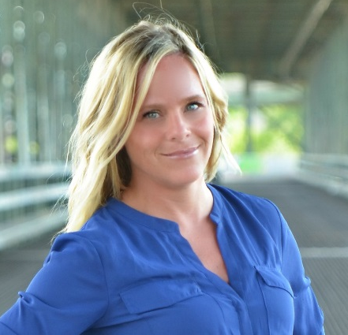
MAGGIE MCCRACKEN, MBA
Maggie McCracken is an IT Project Manager for Quest Diagnostics. She received her Bachelor’s degree from Mid-America University in Organizational Leadership and her Masters of Business Administration, Information Systems from Baker University. She currently lives in Overland Park, KS and is a mother to three boys. Maggie’s hobbies include reading and running and she is an aspiring yoga instructor.

Slide 16
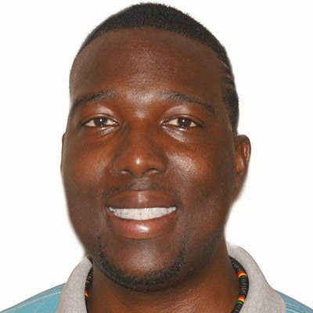
QUEST MOFFAT, MBA
Quest Moffat is a social serial entrepreneur and growth hacker that has a SERIOUS passion in helping other achieve their goals. Quest created and launched Project United Knowledge, a startup studio and venture builder that helps companies create and validate their ideas. Quest is leading the way to help underrepresented individuals create and fund their application and or product ideas.

Slide 17
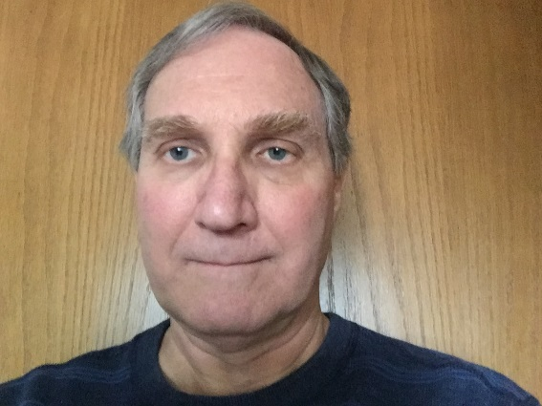
RALPH NATALE
I have been employed at AT&T since 2000 and have been associated with product and tower construction quality for a majority of that time. I recently moved over to the ATO Drone Management Team and have been involved with the drone program since its inception about two years ago. I live near Seattle, Washington where I have been a resident since 1989.

Slide 18
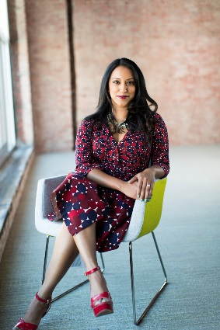
NEELIMA PARASKER, PMP
Neelima is the Founder and CEO of SnapIT Solutions, she is a Bachelor of Engineering in Mechanical and Master of Science in Computer Science with a Project Management Professional (PMP®) Certification from Project Management Institute. She has 15 plus years of experience in IT and held Leadership positions with Fortune 500 Companies, leading teams that perform enterprise transformations and promote innovation using cutting edge technology. SnapIT Solutions is an innovative technology solutions providing software and hardware solutions, IT trainings and Consulting to solve business challenges, improve and enhance the way business is done using innovative technology solutions.

Slide 19
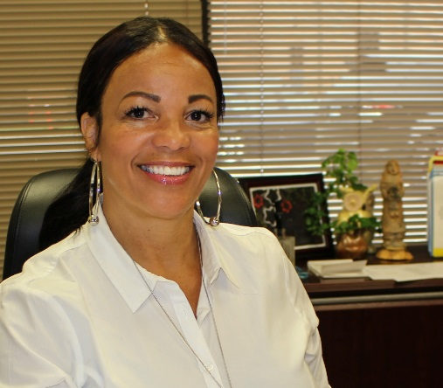
SHELLY PENN, MA
Shelley Penn, MA, began her career with FEC in 1992 as a job developer and has served as the Senior Vice President and Chief Operations Officer of FEC for the past 20 years. Mrs. Penn provides direct oversight of all operational staff, including supervising the delivery of all training and employment activities undertaken by the agency on behalf of its clients. Mrs. Penn also provides direct oversight of the Business Services/Engagement Team comprised of 12 Business Service Workforce Development Professionals, in addition to managing major grants and strategic projects such as the TechHire Grant, America’s Promise Grant, the Health Professions Opportunity Grant (HPOG), the Welfare to Work Program, Employment Re-Entry Programs, WIOA Programs, and Veterans Programs.
The Full Employment Council, Inc. (FEC) is the administrative entity/fiscal agent for the Kansas City & Vicinity Workforce Development Board and the Eastern Jackson County Workforce Development Board. These two Workforce Development Boards (WDB) are comprised of five Missouri counties that represent urban, suburban and rural populations. FEC is a 501(c) (3) non-profit organization with more than 175 years of collective experience in administering and operating a diversity of employment and training programs.

Slide 20
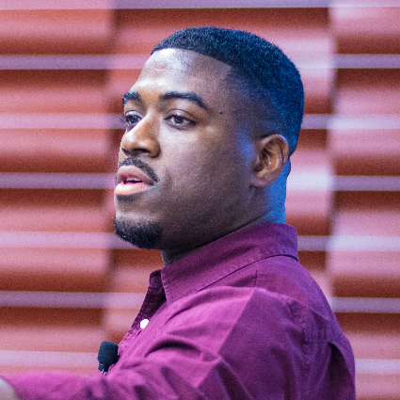
CALVIN ROBERTSON, MBA
Calvin is the designer and developer behind the mobile game DWARF. When it comes to web and app development, he is a technician with the soul of an artist. His unique blend of creativity, tech know-how and business acumen led him into rewarding career opportunities and business developments for himself and others.

Slide 21
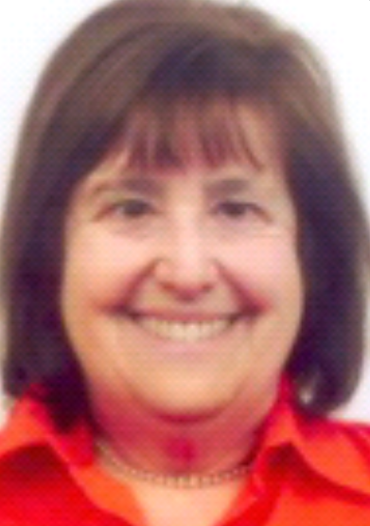
BARBARA SIEFKEN
Barbara Siefken has spent her whole career in the high technology arena. Starting as a software engineer at Texaco, Bell Laboratories and Tektronix, and then migrating to sales and the world of startups, she has experienced many parts of the product development and support process. Along the way she was a visiting professor at Southern University in Baton Rouge, and a trainer for project managers seeking their Project Management Professional certification. She enjoys sharing stories about her breakthroughs and challenges along the way with others.

Slide 22
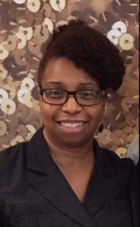
JANETTE SIMS, MS, CFP
Janette Sims is the ninth child out of ten. She is divorced with three adult children (one daughter and two sons). Her educational achievements and activities are:
Associate of Arts (Pre-Business) degree from Kansas City Kansas Community College, Kansas City, KS
Bachelor of Business Administration degree from Baker University, Baldwin City, KS
Certificate in Personal Financial Planning. Candidate to sit for the CFP® (Certified Financial Planner) Certification Examination
Master of Science degree in Family Studies and Human Services, Specialization in Family Financial Planning from Kansas State University, Manhattan, KS
Taught Economics at Hawthorne Elementary School – 3rd Graders for Junior Achievement of Middle America, Inc.
Facilitator/teacher for Financial Empowerment Workshops for adults and teenagers
Financial Counselor for the NBC-CDC Counseling & Spiritual Admonitions Ministry
Leader - NBC L.I.G.H.T. Bearer’s Book Club
Leader - NBC-CDC Life Support Group, Life After Divorce

Slide 23
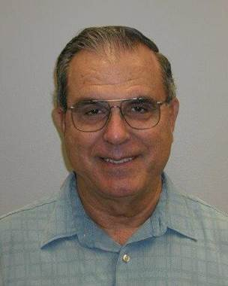
KENNETH SOOK, PE
Electrical Engineering graduate from Wichita State University in 1968. Obtained PE certification license in 1974 and have worked for AT&T for 49 plus years mainly in switching and transport engineering.

Slide 24
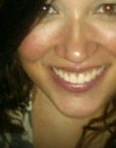
KASEY WALZ, BA
Worked for AT&T for 17 years. Currently serving as a Technical Support Manager for Network Services. Received B. A. degree in Accounting. Kasey is an avid reader and loves tending her beautiful flower garden.

Slide 25
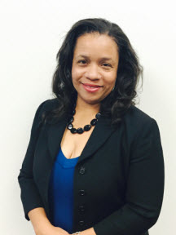
COURTNEY WELLS, PMP, MBA
Courtney Wells has been in the field of information technology for 20+ years specializing in IT software implementations and Software as a Service (SaaS) from product inception through development and launch, PMO Management, Professional Services and Business Process Automation. Courtney’s diverse experience and background spans several industries and ranges from project and program portfolio management, software development, finance, services marketing, business operations, support services and IT consulting.
She holds a B.S. in Computer Information Systems, an MBA specializing in Strategic Project Management, Six Sigma Green Belt certified, ITIL Foundations certified and holds a PMP certification. Courtney is part of the leadership team at HNTB Engineering Firm in downtown Kansas City where she manages the IT Project Delivery Office responsible for program management and delivering the technology supporting needs for the firm’s major infrastructure projects including bridges, highways, stadiums, etc.
Prior to leading the IT PMO at HNTB, Courtney was a senior level project/program manager and PMO leader at Hewlett-Packard for the previous 15 years where she was responsible for leading the SaaS Business PMO and a $34 million dollar P&L. One of her greatest passions is to streamline inefficient processes through the use of technology. Some of her hobbies include traveling, playing the violin and coaching robotics. She also enjoys volunteering in the community and is the Executive Vice-President and Project Director of the Black Family Technology Awareness Association of KC.

Slide 26
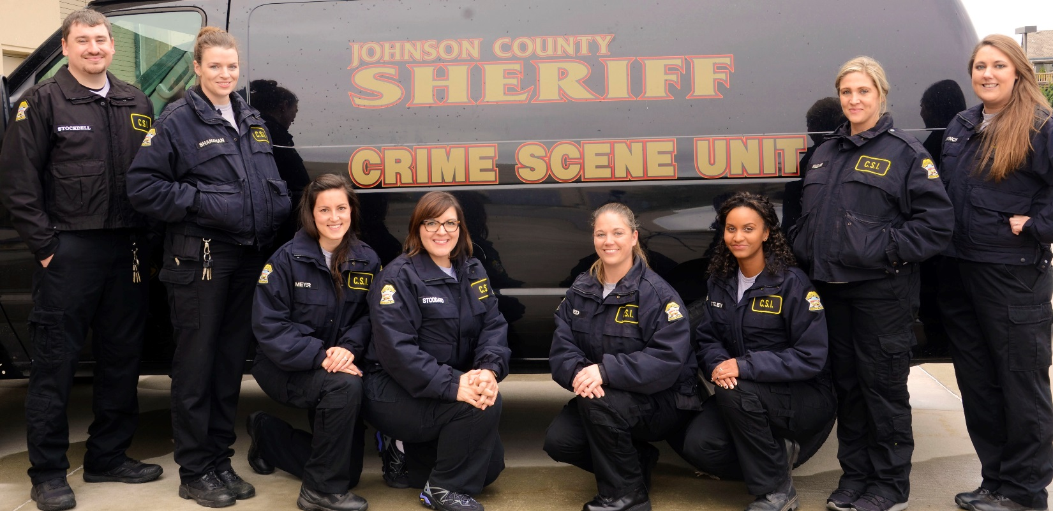
JOHNSON COUNTY CRIME SCENE UNIT
Our CSI Unit responds to crime scenes and handles all documentation, photography, evidence collection and processing of that scene and testify in court to our findings. We document scenes through our 3D laser scanning, note taking, photography, shooting scene reconstruction, and bloodstain pattern analysis. Members of our unit have a variety of bachelor’s and master’s degrees in Chemistry, Biology, Forensic Science and Anthropology.

Slide 27
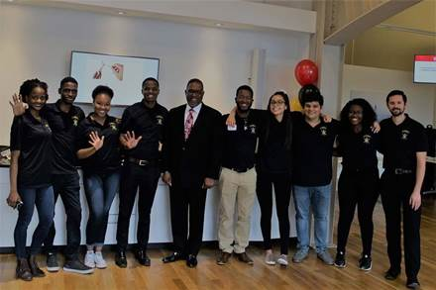
NATIONAL SOCIETY OF BLACK ENGINEERS
The National Society of Black Engineers is one of the largest student-run organizations in the United States focused on increasing the amount of successful minority engineers. NSBE's mission and objective is "to increase the number of culturally responsible Black Engineers who excel academically, succeed professionally and positively impact the community." Our UMKC chapter upholds to this commitment by being active in our community and being a support system for one another.

Slide 28


